Slide 1
Debugging
Module 6
Notes:
Version: 12/10/2019 17:20:30

Slide 2
Disclaimer

Slide 3
Learnings covered in this Unit
Debugging Introduction
Debugging In The ISE
Additional Debugging Cmdlets
Breakpoints
Debugger Actions
Debugging In VSCode Demo

Slide 4
Debugging Overview

Slide 5
Debugging Overview
Process of identifying and removing errors
Interactive investigation
Suspend code during execution
Breakpoints
Debugger Exclusive Code
Call stack
Writing to console/logs

Slide 6
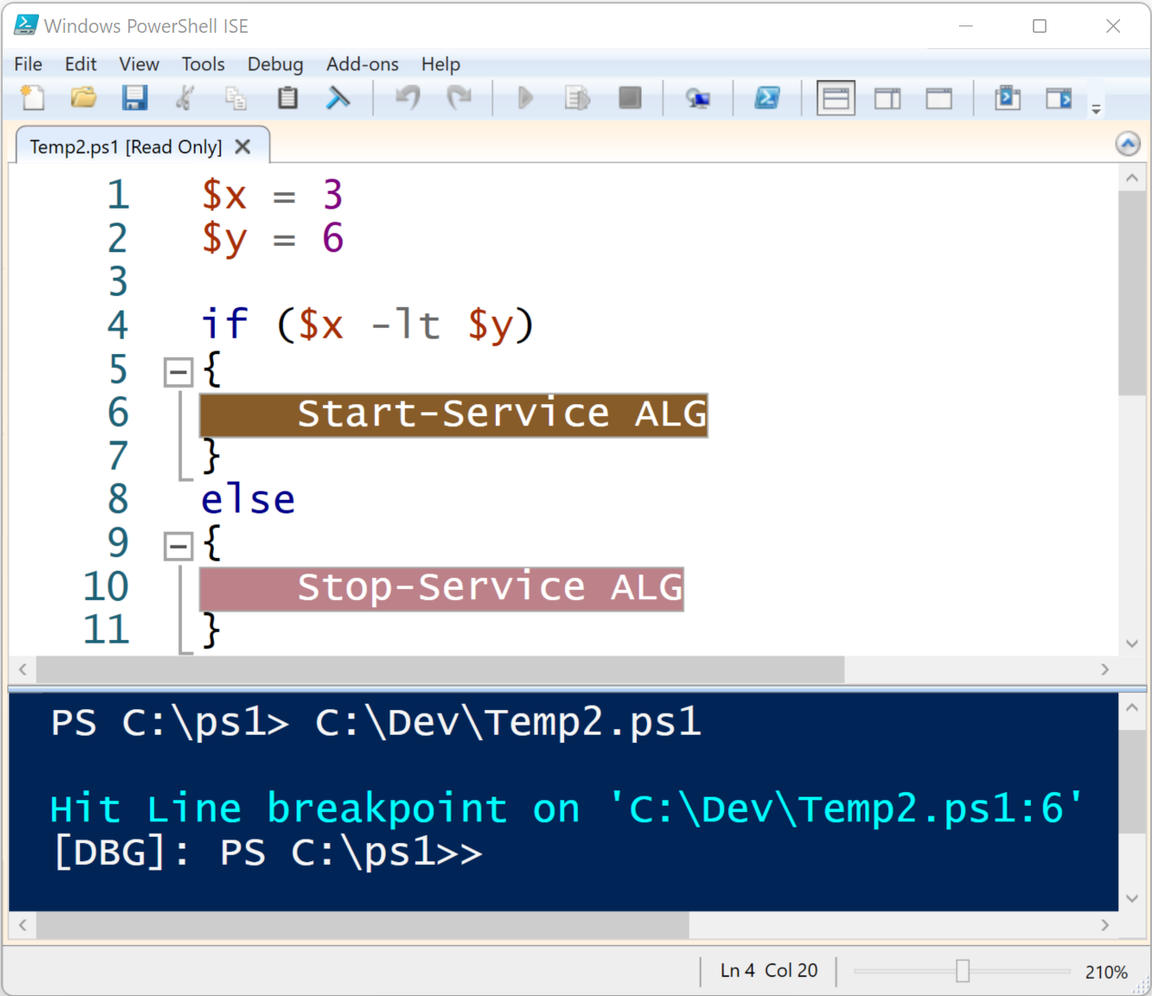
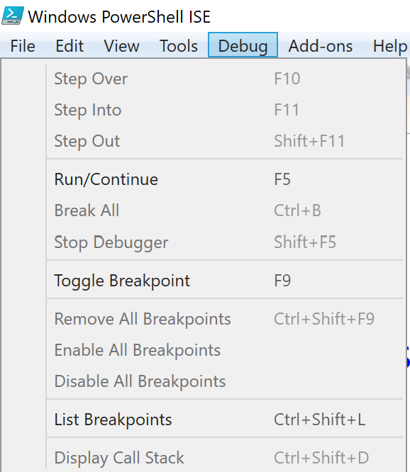
ISE Debugger Visual

Slide 7
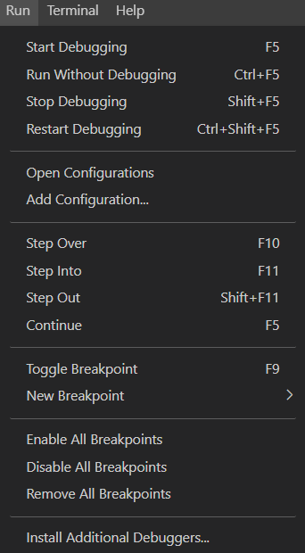
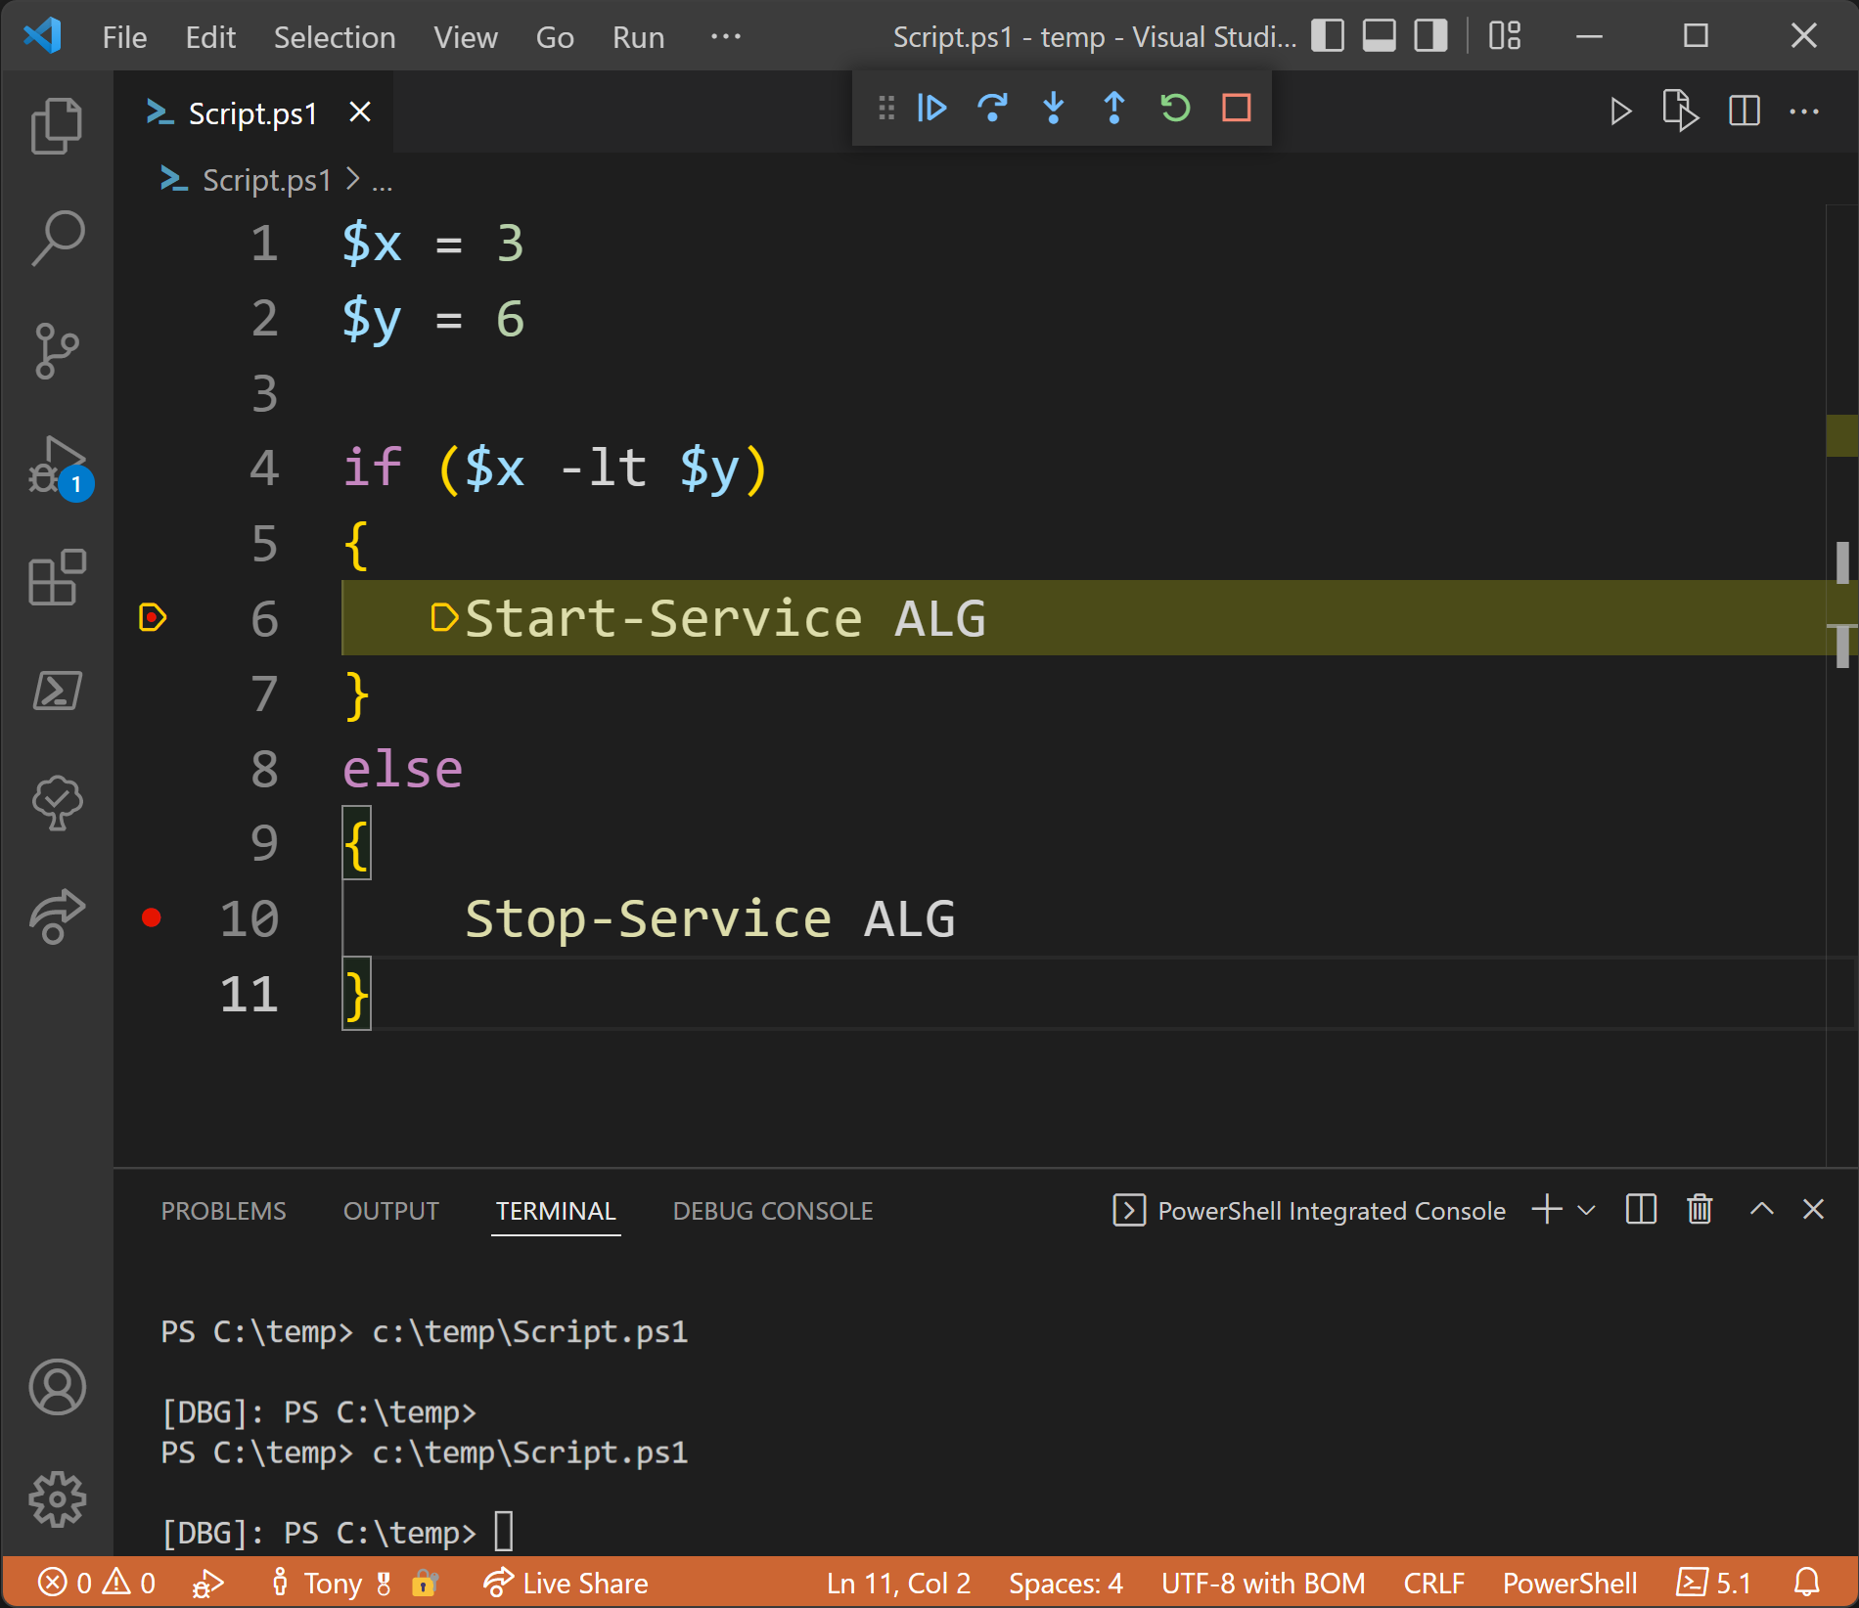
VS Code Debugger Visual

Slide 8
Breakpoints

Slide 9
Breakpoints
Point in the code to suspend a script and start the debugger
Created in GUI or command line with Set-PSBreakpoint
Line Numbers
Commands Functions
Variable Read/Write

Slide 10
Managing Breakpoints
Create
Set-PSBreakpoint
Remove-PSBreakPoint
Get-PSBreakpoint
Enable-PSBreakpoint
ISE (line only)
Manage
Disable-PSbreakpoint

Slide 11
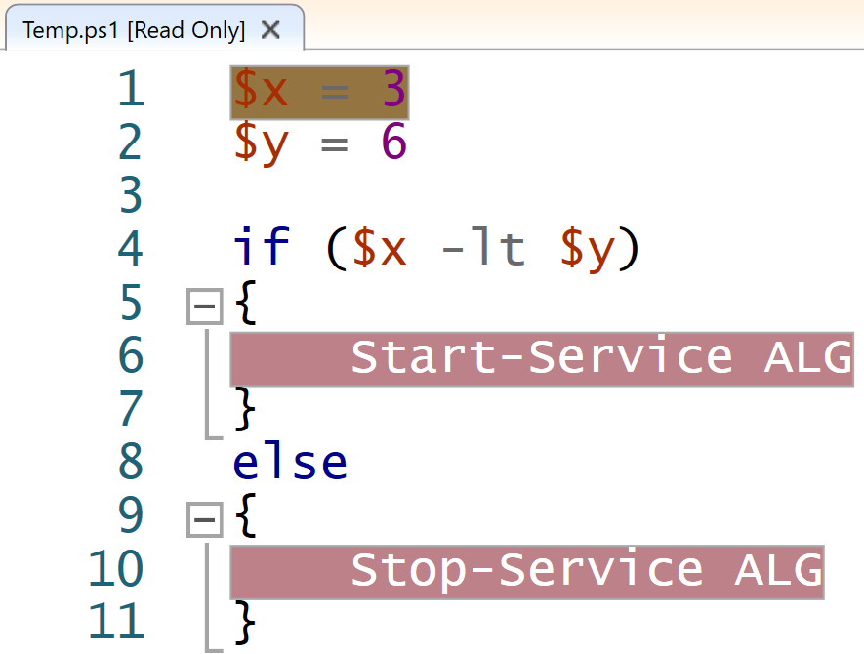
Breakpoint Cmdlets
PS> Set-PSBreakpoint -Script .\temp.ps1 -Command Start-Service
PS> Set-PSBreakpoint -Script .\temp.ps1 -Variable x
PS> Get-PSBreakpoint
ID Script Line Command Variable Action
-- ------ ---- ------- -------- ------
9 Temp.ps1 Start-Service
10 Temp.ps1 6
11 Temp.ps1 10
12 Temp.ps1 x
PS> .\Temp.ps1
Hit Variable breakpoint on 'C:\ps1\temp.ps1:$x' (Write access)
[DBG] PS>

Slide 12

Demonstration
Debugging basics

Slide 13

Questions?

Slide 14
Working With The Debugger

Slide 15
Actions
Step Over – F10
Step Into – F11
Step Out – Shift+F11
Continue – F5
Run code until next breakpoint
Run the current line of code
Enters the function or script called from the current line
Finishes the current function and exits to the parent scope

Slide 16
Call Stack
When a command is called, it is added to the top of the stack
Get-PSCallStack shows all current commands on the stack
Parameter values are tracked on the call stack
A map of the functions called to arrive at the current line of code
Commands are executed from the top of the stack
Command Arguments Location
------- --------- --------
Bam {bam=8} CallStack.ps1: line 23
Wam {wam=7} CallStack.ps1: line 16
Bar {bar=6} CallStack.ps1: line 10
Foo {foo=5} CallStack.ps1: line 4
CallStack.ps1 {} CallStack.ps1: line 26

Slide 17
Get-PSCallStack Example
Function Foo{
param($foo)
Bar -bar ($foo+1)
}
Function Bar{
param($bar)
Wam -wam ($bar+1)
}
Function Wam{
param($wam)
Bam -bam ($wam+1)
}
Function Bam{
param($bam)
Write-Host ($bam+1)
Get-PSCallStack
}
Foo -foo 5
PS> C:\CallStack.ps1
9
Command Arguments Location
------- --------- --------
Bam {bam=8} CallStack.ps1: line 23
Wam {wam=7} CallStack.ps1: line 16
Bar {bar=6} CallStack.ps1: line 10
Foo {foo=5} CallStack.ps1: line 4
CallStack.ps1 {} CallStack.ps1: line 26

Slide 18
Command line shortcuts
[DBG] PS> ?
s, stepInto Single step (step into functions, scripts, etc.)
v, stepOver Step to next statement (step over functions, scripts, etc.)
o, stepOut Step out of the current function, script, etc.
c, continue Continue operation
q, quit Stop operation and exit the debugger
d, detach Continue operation and detach the debugger.
k, Get-PSCallStack Display call stack
l, list List source code for the current script.
Use "list" to start from the current line, "list <m>"
to start from line <m>, and "list <m> <n>" to list <n>
lines starting from line <m>
<enter> Repeat last command if it was stepInto, stepOver or list
?, h displays this help message.

Slide 19
Demonstration
Debugging basics

Slide 20
Questions?

Slide 21
Additional Techniques

Slide 22
Writing To The Console
Helps determine where break points are needed
Write-Debug
Defaults to inquire (prompt) when using –Debug
Controlled with $DebugPreference
Write-Verbose
Defaults to continue (display) when using –Verbose
Controlled with $VerbosePreference
Information being written can usually double as verbose logging when done
Convenient to track down code causing a script to hang
Monitor variable values without break points

Slide 23
$PSDebugContext
Detect if the debugger is active for debug specific output/actions
Investigate the InvocationInfo property
[DBG] PS> $PSDebugContext.InvocationInfo
MyCommand :
BoundParameters : {}
UnboundArguments : {}
ScriptLineNumber : 23
OffsetInLine : 5
HistoryId : 27
ScriptName : C:\CallStack.ps1
Line : Get-PSCallStack
PositionMessage : At C:\CallStack.ps1:23 char:5
+ Get-PSCallStack
+ ~~~~~~~~~~~~~~~
PSScriptRoot : C:\
PSCommandPath : C:\CallStack.ps1
ExpectingInput : False
CommandOrigin : Internal

Slide 24
Debugging Cmdlets

Slide 25
Cmdlets
Set-StrictMode
Set-PSDebug
Trace-Command

Slide 26
Set-StrictMode
Generate terminating errors based on best practices
Version 1+
Version 2+
Function calls that use the syntax for calling methods.
Version 3 & Latest
References to uninitialized variables
References to non-existent properties of an object.
Access out of bounds array indexes
Identify typos for variables or properties

Slide 27
Example: Set-StrictMode
PS> $Var
PS> $Var = 0..5
PS> $Var.FakeProperty
PS> $Var[100]
PS> Set-StrictMode -Version latest
PS> $Var[100]
Index was outside the bounds of the array.
At line:1 char:1
PS> $Var.FakeProperty
The property 'FakeProperty' cannot be found on this object.
Verify that the property exists.
PS> $DoesNotExist
The variable '$DoesNotExist' cannot be retrieved because it has not been set.

Slide 28
Trace Data
Set-TraceSource
Trace-Command
Debug information for PowerShell Components
ParameterBinding
TypeConversion
Get-TraceSource
List available components to trace
Assign a trace to the global scope
Trace a specific script block

Slide 29
Example: Trace parameter binding
PS> Trace-Command -PSHost -Expression {Start-Process Notepad} -Name ParameterBinding
DEBUG: ParameterBinding Information: 0 : BIND NAMED cmd line args [Start-Process]
DEBUG: ParameterBinding Information: 0 : BIND POSITIONAL cmd line args
[Start-Process]
DEBUG: ParameterBinding Information: 0 : BIND arg [Notepad] to parameter [FilePath]
DEBUG: ParameterBinding Information: 0 : Executing VALIDATION metadata: [System.Management.Automation.ValidateNotNullOrEmptyAttribute]
DEBUG: ParameterBinding Information: 0 : BIND arg [Notepad] to param [FilePath] SUCCESSFUL
DEBUG: ParameterBinding Information: 0 : MANDATORY PARAMETER CHECK on cmdlet
[Start-Process]
DEBUG: ParameterBinding Information: 0 : CALLING BeginProcessing
DEBUG: ParameterBinding Information: 0 : CALLING EndProcessing
Notes:
Output adjusted to help show line word-wraps

Slide 30
Set-PSDebug
Turns script debugging features on and off
Sets the trace level
Toggles strict mode
Enables step mode
Set-PSDebug -Trace 2
Function Foo {
Write-Host "Foo"
}
Foo
$Var = "Hello World"
DEBUG: 1+ >>>> Set-PSDebug -Trace 2
DEBUG: ! CALL function '<ScriptBlock>'
DEBUG: 5+ >>>> Foo
DEBUG: 3+ Function Foo >>>> {Write-Host "Foo"}
DEBUG: ! CALL function 'Foo'
DEBUG: 3+ Function Foo{ >>>> Write-Host "Foo"}
Foo
DEBUG: 3+ Function Foo {Write-Host "Foo" >>>> }
DEBUG: 7+ >>>> $Var = “Hello World"
DEBUG: ! SET $Var = ‘Hello World'.

Slide 31
Demonstration
Debugging - other commands

Slide 32
Questions?

Slide 33
Debugging In Visual Studio Code

Slide 34
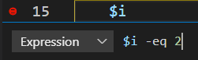
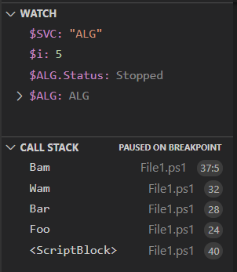
Visual Studio Code Debugger
Convenient Variables
Call Stack Window
Conditional Breakpoints
Monitor specific properties
Mouseover object info
Watch Window
Same core capabilities as ISE

Slide 35
Demonstration
Debugging - advanced

Slide 36
Questions?

Slide 37

Debugging
45 Minutes

Slide 38
Microsoft

